Slide 1
Project report on news feed(Gatherly)
Submitted by:
Lanka Sai Krishna
Deepchand
Subhash

Slide 2
Acknowledgement
The success and final outcome of this project required a lot of guidance and assistance from many people and we are extremely privileged to have got this all along the completion of our project. All that we have done is only due to such supervision and assistance and we would like to thank prof. Preethi Khanna ma’am for the help. We would also like thank PhD Scholar Neha Gour for her guidance.

Slide 3
Abstract
Gatherly is used to connect people. It lets them to share posts with their friends and family.

Slide 4
Table of Contents
Introduction
Data Tables
ER model diagram
Technology used
Overview and Scope

Slide 5
Introduction
To explain it simply, we will discuss the purpose of it. The purpose of this application are as follows :
The software is for digitalizing everything about the news feed.
It helps people to easily access the information about the news and posts shared by their friends.

Slide 6
Data Tables
Users
Posts
Friend Request
Notifications
Comments
Likes

Slide 7
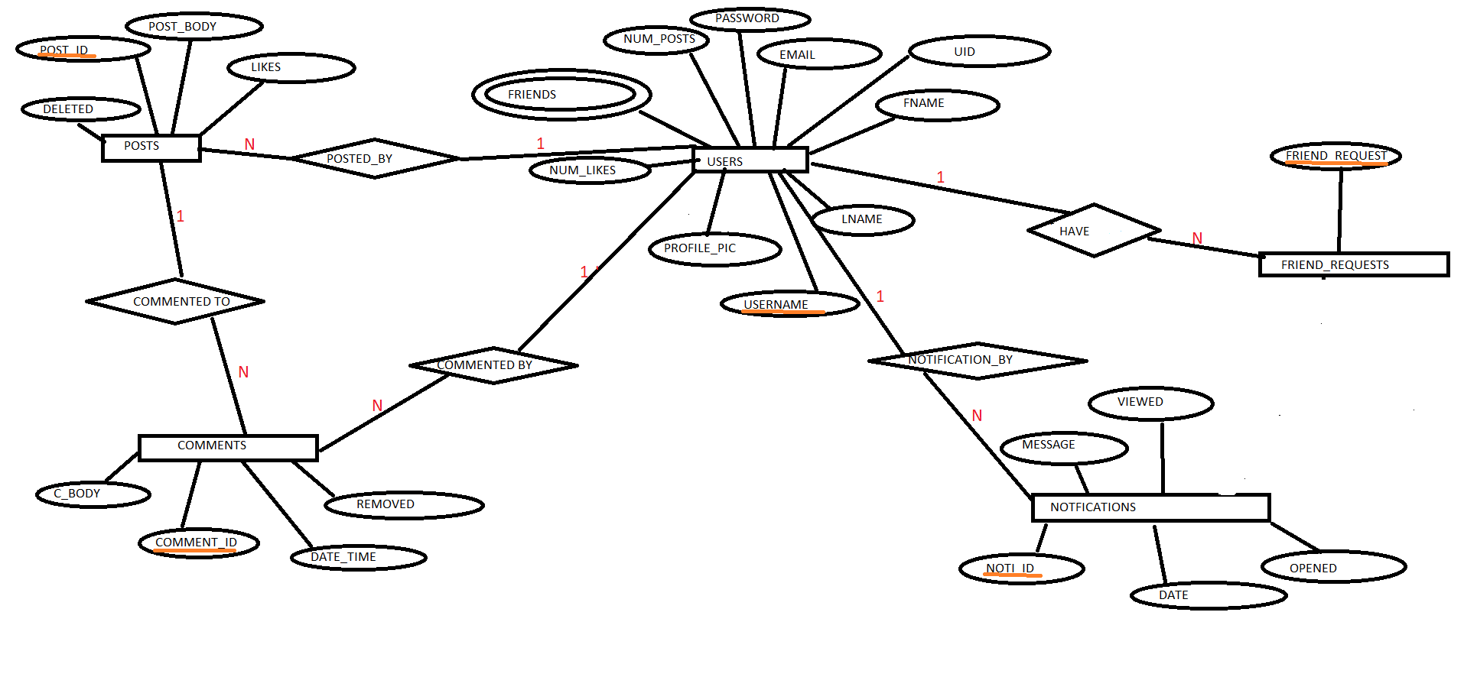
ER Model Diagram

Slide 8
Technology Used
Front end: HTML, CSS, JavaScript
Back end: Apache MySQL, PHP

Slide 9
Overview and Scope
Users can register in gatherly with a user name and a email
It allows them to send friend request to their friends if they have a gatherly account.
Posts can be shared with their friends.
It is a kind of social media.

